Slide 1
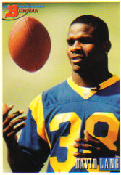
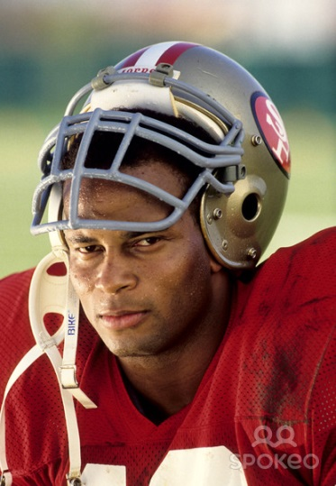
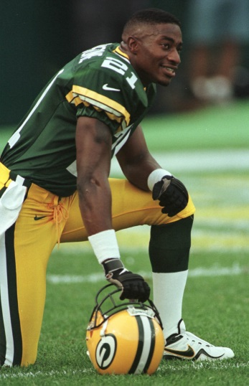

Super Bowl Alumni
Eisenhower High School

Slide 2
David Lang

Slide 3
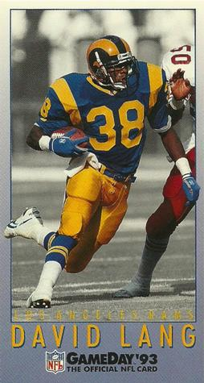
David Lang
He was born on March 28, 1967.
He graduated from Eisenhower in 1986.
He accepted a scholarship to play college football for Northern Arizona University.

Slide 4
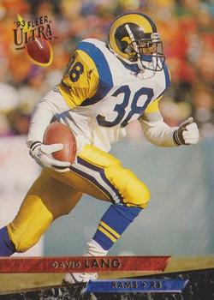
David Lang
Lang was drafted in the 12th round of the 1990 NFL Draft by the Los Angeles Rams.
On April 27, 1995, he signed with the Dallas Cowboys as a free agent.
He was part of the Super Bowl XXX winning team and retired at the end of the season.

Slide 5
Craig Newsome

Slide 6
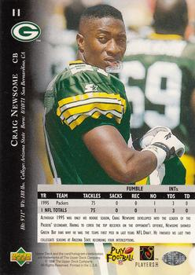
Craig Newsome
He was born on August 10, 1971.
He played for Eisenhower High School in Rialto, CA and attended San Bernardino Valley College and later transferred to Arizona State University.

Slide 7
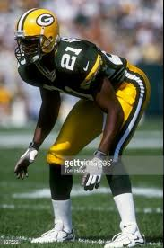
Craig Newsome
The Packers drafted Newsome with the 32nd pick in the 1995 NFL Draft.
He was the starting cornerback on the 1996 Green Bay Packers championship team.

Slide 8
Ronnie Lott

Slide 9
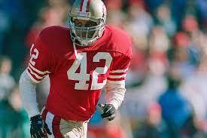
Ronnie Lott
He was born May 8, 1959.
He attended Frisbie Junior High and Eisenhower High School in Rialto, California, where he played football under Coach Bill Christopher and graduated in 1977.

Slide 10
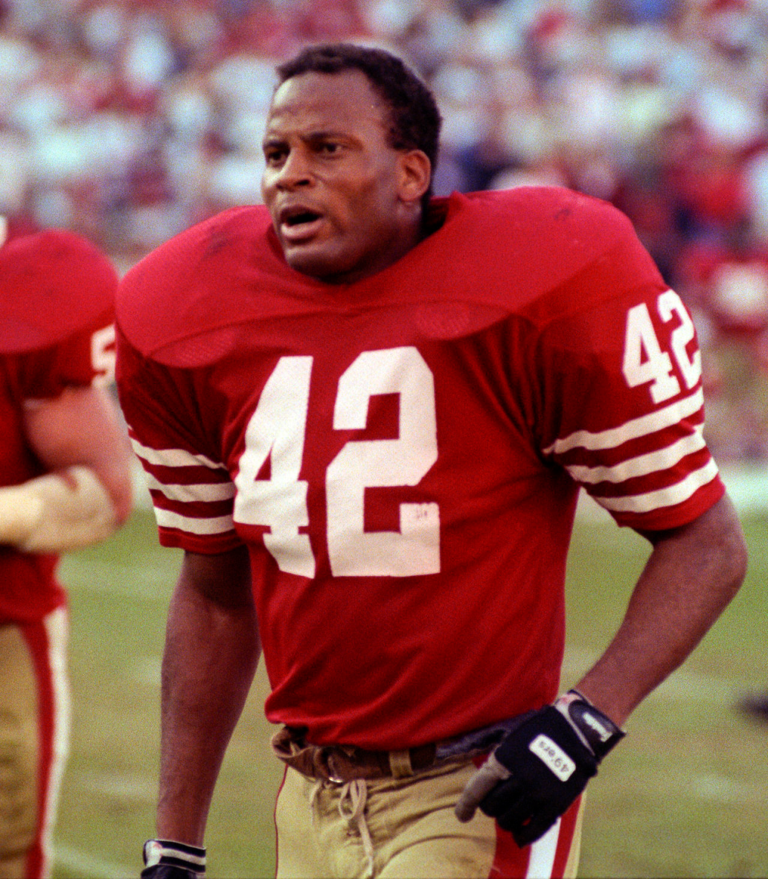
Ronnie Lott
During his years at USC (1977–1980), he helped the team to a share of the 1978 national championship and played in the 1979 and 1980 Rose Bowls.
In 2002, he was inducted as one of 15 new members (I-A class) of the College Football Hall of Fame.
He was also a 1995 inductee to the USC Athletic Hall of Fame.
Lott was drafted by the San Francisco 49ers in the first round (8th overall pick) of the 1981 NFL Draft.

Slide 11
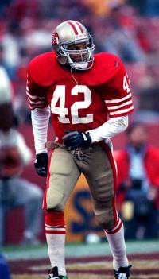
Ronnie Lott
In his first season, he recorded seven interceptions, helped the 49ers to win Super Bowl XVI, and also became only the second rookie in NFL history to return three interceptions for touchdowns.
In his 10 years with the 49ers, Lott helped them win eight division titles and four Super Bowls: XVI (1981 season), XIX (1984), XXIII (1988), and XXIV (1989).

Slide 12
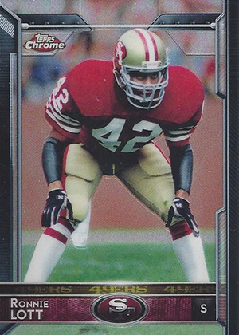
Ronnie Lott
Lott signed as a free agent in 1991 with the Los Angeles Raiders, and in 1993 with the New York Jets.
In 1995, Lott signed a free agent deal with the Kansas City Chiefs.

Slide 13
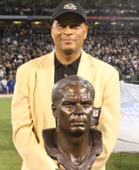
Ronnie Lott
He returned to the 49ers in 1995, but soon retired before the season began.
He was elected to the Pro Football Hall of Fame in 2000, his first year of eligibility, and was also named to the NFL's 75th Anniversary Team.

Slide 14


